Slide 1
RevPasswaord Manager
Presented by – Shubhada Shingate
Trainer: Manisha Shah

Slide 2
INTRODUCTION
Password Manager is a secure console-based application designed to help users store and manage passwords for multiple online accounts.
This application allows users to create an account using a master password, generate strong passwords, and securely store credentials.
It uses a master password and encryption to protect sensitive data and provides basic password management features.
The application provides features like password generation, storage, and recovery using security questions.

Slide 3
Problem Statement
To develop a secure, easy-to-use tool that safely stores and manages passwords as many users struggle to remember strong and unique passwords for multiple online accounts.

Slide 4
Features
Create a user account with a master password
Log in securely to access the password vault
Add, update, and delete passwords for various accounts
View individual password details
Search passwords
Generate strong random password
Recover forgotten passwords using security question and verification codes

Slide 5
Technology Used
Programming Language: Java
Database: MySQL
Connectivity: JDBC
Security: Password Encryption
Testing: Junit

Slide 6
Flowchart Representation
START
Master Register
Login
Forgot Password
Add/Update
Profile Manager
Search
Logout
Update
Question Manager
Reset Pass

Slide 7
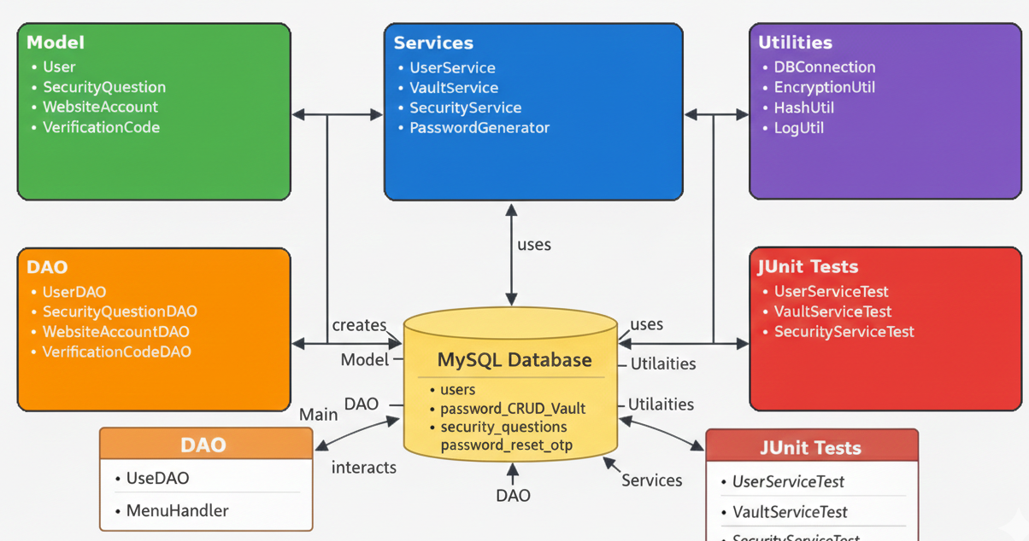






Project- ERD
in that give a relation between this

Slide 8
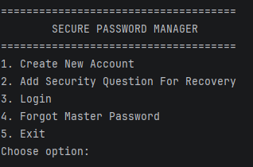
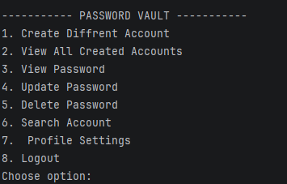
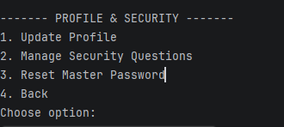
Console Demo

Slide 9
Conclusion
Developed a secure console-based Password Manager for storing and managing passwords safely
Allows users to create, update, view, delete, and search passwords with master password protection
Implements password encryption and security questions for enhanced data protection
Provides a simple and user-friendly console interface where user can manage multiple account credentials securely and efficiently

Slide 10


